Slide 1


[--Please make a copy of this template--]
Hello! ​
My name is ​
[--your name--] ​
By Connection Dialogue​
[--Put your portrait in the background–]

Slide 2
[put some photos about your program]​
I am currently a
[--student--]​
I came from: [--the school--]
I study in: [--your program--]

Slide 3
[put some photos about your work]​
more info of my new life
What your program do:
[--description--]
My best work: [--your best work--]
Why I like this work: [--description--]
My partners in this work: [--name--]

Slide 4
[put some photos about your home]​
I am from
[--your home country--]​
I used to be a:
[--your role back in hometown—]
My job was:
[--what you used to do for live--]

Slide 5
[put some photos about your work]​
more info of my old life
What your old work did:
[--description--]
My best work: [--your best work--]
Why I like this work: [--description--]
My partners in this work: [--name--]

Slide 6
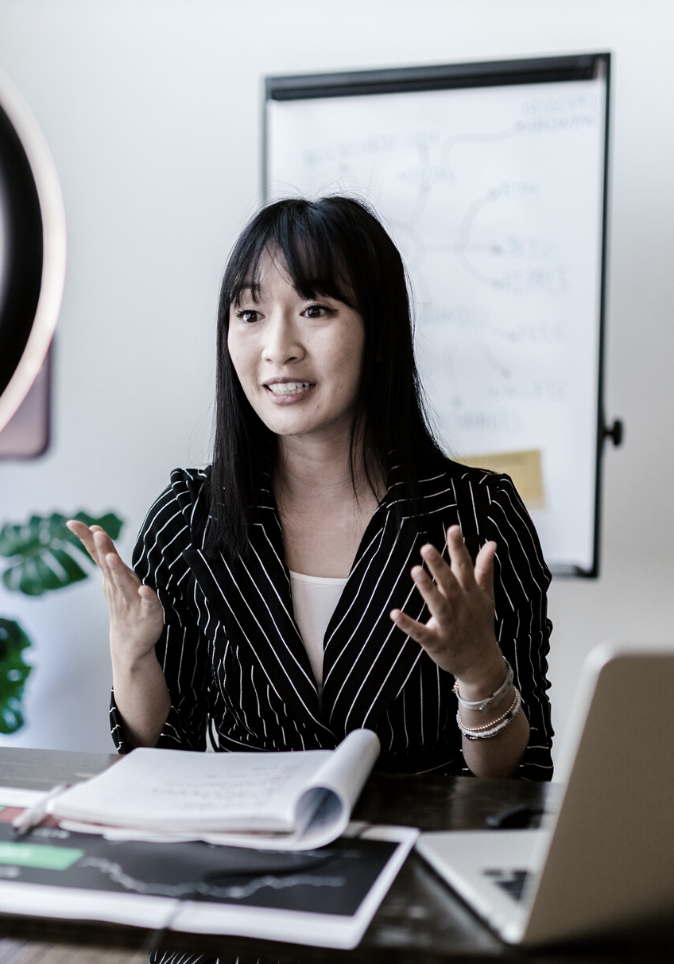
[--Put the person’s photo here–]
The Coolest person I ever meet in canada
[--why you think this person is the coolest--]

Slide 7
[--Put the person’s photo here–]
The Coolest person i ever meet in my home country
[--why you think this person is the coolest--]

Slide 8

My habbies
[--description--]
[--description--]
[--description--]
[--description--]
[--description--]

Slide 9
My Special skills
[--description--]
[--description--]
[--description--]
[--description--]
[--description--]

Slide 10

what i want to be in canada:
1.
[--dream 1--]
[--try to share more specific details in your ideal life in Canada--]
[--Put photo here–]
2.
[--dream 2--]
[--try to share more specific details in your ideal life in Canada--]
3.
[--dream 2--]
[--try to share more specific details in your ideal life in Canada--]

Slide 11
people who need help in my life-1
Name:
Relationship:
Needs:
phone:
email:
social media:

Slide 12
people who need help in my life-2
Name:
Relationship:
Needs:
phone:
email:
social media:

Slide 13
people who need help in my life-3
Name:
Relationship:
Needs:
phone:
email:
social media:

Slide 14

[--one line promotion of yourself--]

Slide 15
thank you very much
phone:
email:
social media:

